Slide 1
Coaching for
Improved Performance
An Overview

Slide 2

Coaching for Improved Performance
Goal: When coaching, make employees feel that you are helping them rather than just being critical.
Method: Practice coaching your role-player Brooke Lerner
  Use the 5 - 7 Model whose elements are like those in most other coaching models
  Practice with Brooke will increase your retention and build your skills

Slide 3
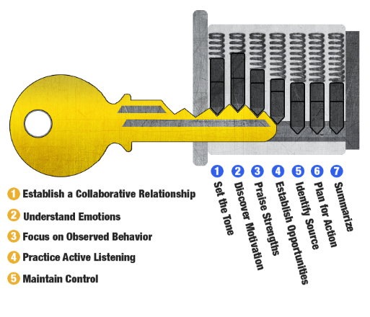
Coaching Five Keys and Seven Steps

Slide 4
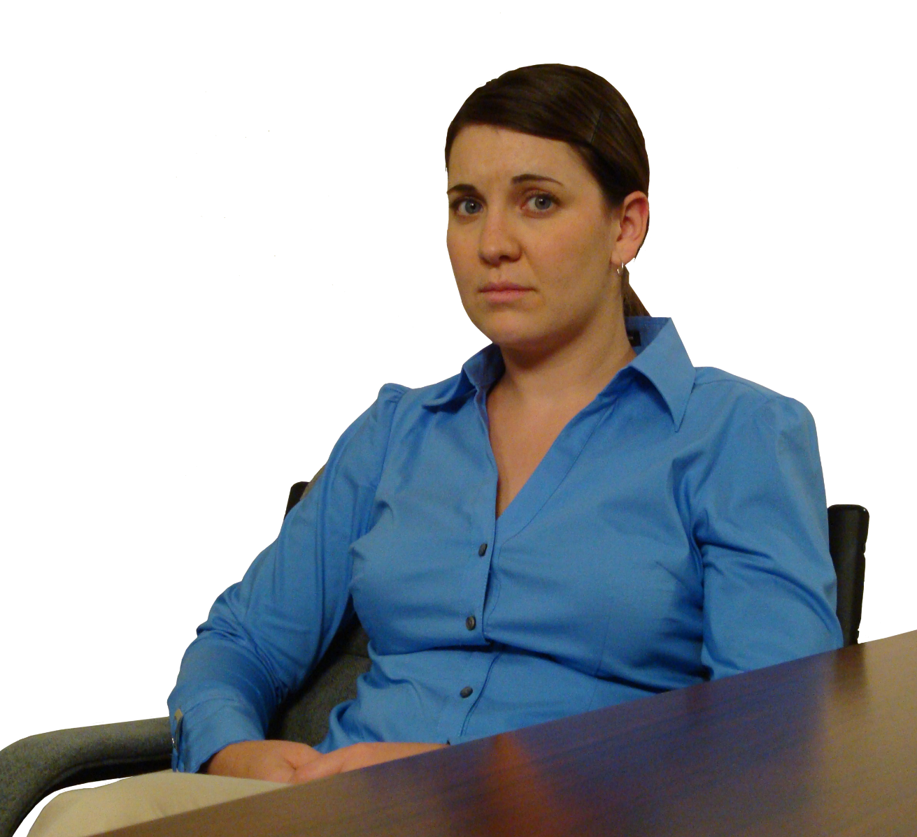
The Experiential Learning Scenario
Brooke Learner (26 years old)
  Has only been your subordinate for three months, but worked for your company for two years
  Is great with outside customers
Brooke is underperforming
  Disrupting meetings
  Missing deadlines
Coaching her is never the same twice

Slide 5

The Case
Brooke has six distinct personalities
  Argumentative alpha
  Passive aggressive victim
  Angry histrionic
  Apathetic underachiever
  Sensitive sycophant
  Blaming incompetent
You will be provided with a wide variety of experiences, ranging over situations like those listed

Slide 6
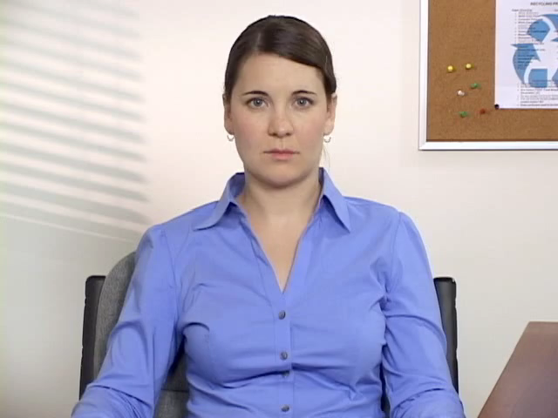
Seven Steps
Step 1: Set the Tone
  State the purpose of the conversation.
  Set the tone by saying something positive; for example, “Good to see you, Brooke. I appreciate you taking the time to sit down with me.”
Click the picture to hear one of Brooke’s Response

Slide 7
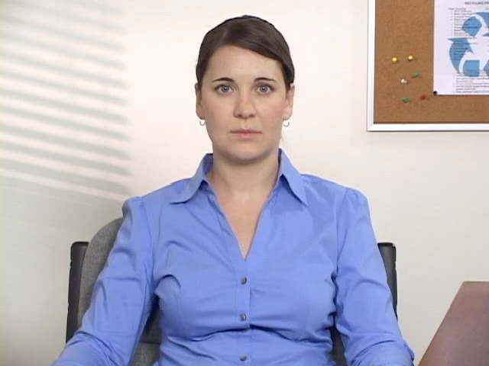
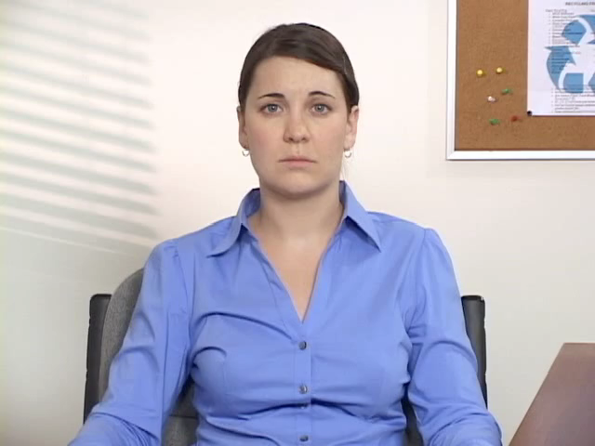
Seven Steps
Step 2: Discover Motivation
  Ask about career goals and/or what motivates her at work.
Step 3: Praise Strengths
  Ask Brooke what she sees as her greatest strength or identify and confirm her strengths.
  Ask about other strengths.
Click the pictures to hear two of Brooke’s responses

Slide 8
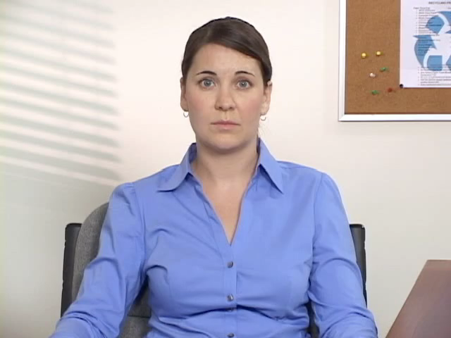
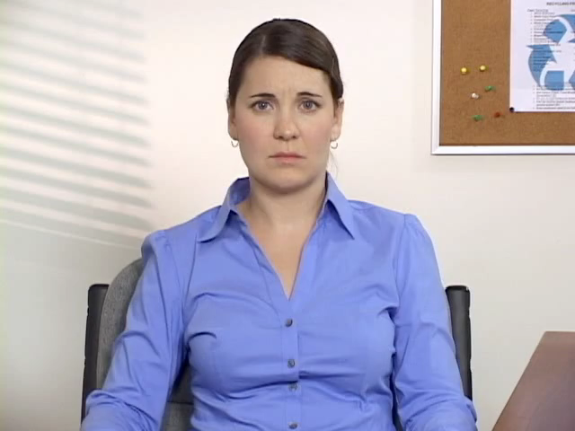
Seven Steps
Step 4: Establish Opportunities
  Ask Brooke to identify opportunities for improvement.
  Discuss the deadline problem that you have observed.
  Discuss the meeting participation problem that you have observed.
Click the pictures to hear two of Brooke’s responses

Slide 9
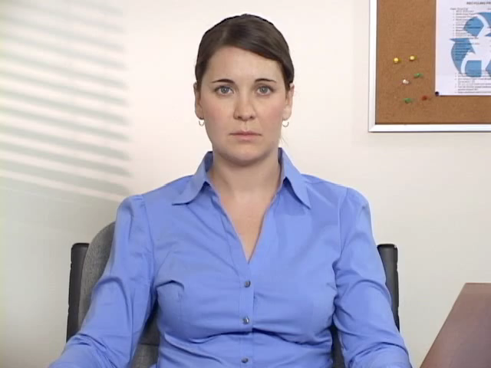
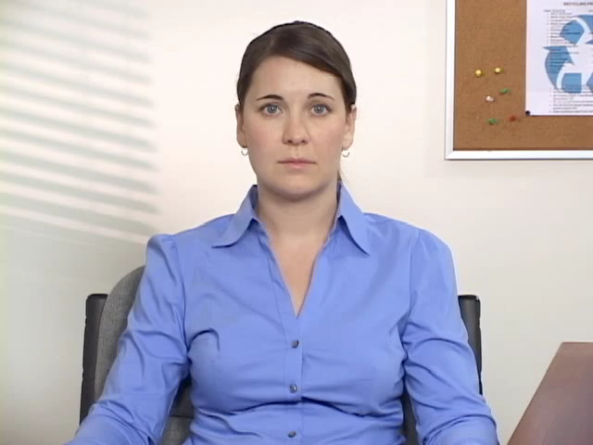
Seven Steps
Step 5: Identify Source
  Ask Brooke to try to determine the source of her missed deadlines.
  Confirm or help Brooke discover the source of her missed deadlines.
  Ask Brooke to try to determine the source of her performance issue in team meetings.
  Confirm or help Brooke discover the source of her performance issue in team meetings.
Click the pictures to hear two of Brooke’s responses

Slide 10
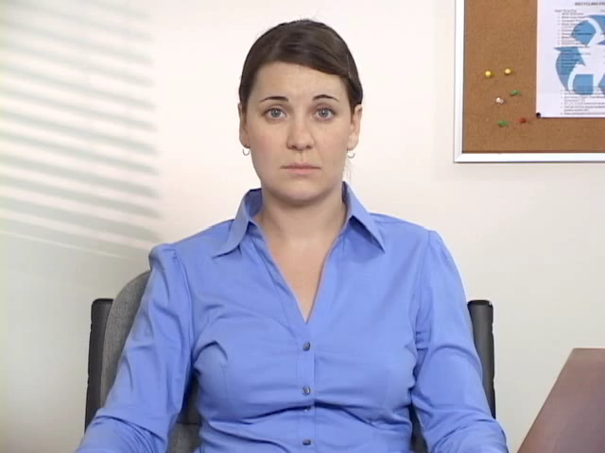
Seven Steps
Step 6: Plan for action
  Ask for Brooke's help in creating a plan to meet more deadlines.
  Ask for Brooke’s help in creating a plan to improve her performance in team meetings.
Click the picture to hear one of Brooke’s responses

Slide 11
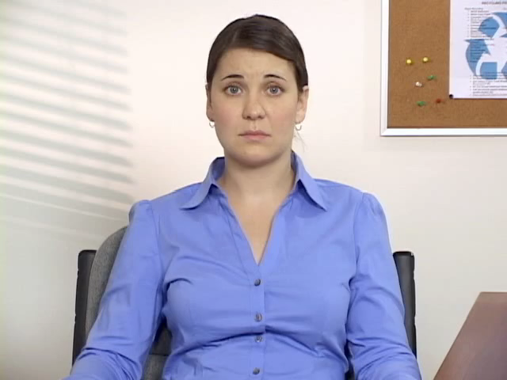
Seven Steps
Step 7: Summarize
  Confirm a mutually agreed-upon plan to help Brooke meet more deadlines.
  Confirmed a mutually agreed-upon plan to help Brooke improve her performance in team meetings.
  Gain Brooke’s buy-in that she is committed to improving her performance.
  Summarize what you and Brooke discussed and agreed upon.
  Scheduled a follow up meeting with Brooke to discuss her progress.
Click the picture to hear one of Brooke’s responses

Slide 12
Five Keys
Establish a Collaborative Relationship.
  Asking for Brooke’s input and feedback during a discussion will give her a greater sense of value and improve her morale
  Include Brooke in both the discovery and decision-making phases of the session and frequently ask for her input
“I'd like you to think about ways in which you could be an even stronger team member.”
“I'd like you to feel like you can contribute to the meetings in a more positive way. What could we do to make you more engaged?”

Slide 13
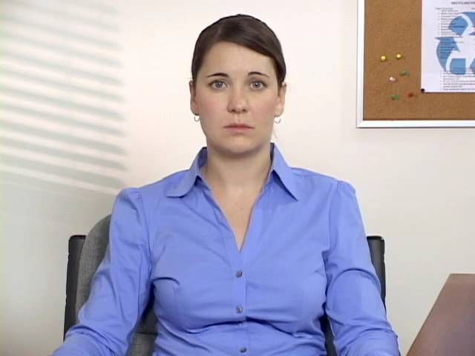
Five Keys
2. Understand Emotions.
  No one likes to hear that they are not doing a good job. Brooke may display more emotions during a coaching discussion than she displays on a typical day at work
  Be prepared for Brooke to be defensive, withdrawn, angry, or even show superficial acceptance
  Be sure to validate Brooke’s emotions and utilize them to engage her in further discussions
Click the picture to hear one of Brooke’s responses

Slide 14
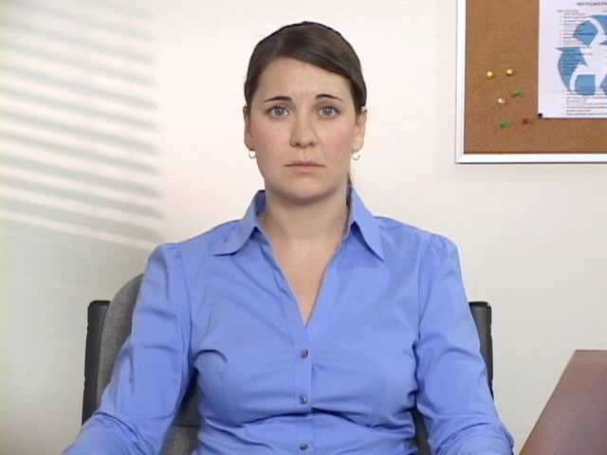
Five Keys
“I've picked up on some problematic behavior in our team meetings. Do you know what I'm referring to?”
3. Focus on Observed Behavior.
  Limit the conversation to objective behaviors you saw or heard yourself, even if you gathered information from other employees
  Sharing information provided by others may make Brooke defensive
  Utilize examples from your own observations and be careful not to make judgments about those behaviors
Click the picture to hear one of Brooke’s responses

Slide 15
Five Keys
4. Practice Active Listening.
  Everyone likes to know that what they have to say matters. This means that, as a manager, you must demonstrate to Brooke that you heard and understood what she said
  Use techniques such as summarizing, paraphrasing, reflecting, and clarifying to convey your understanding
“What I'm hearing from you is that you're making an effort to fit in with your new team by showing them that you agree with their ideas in meetings.”

Slide 16
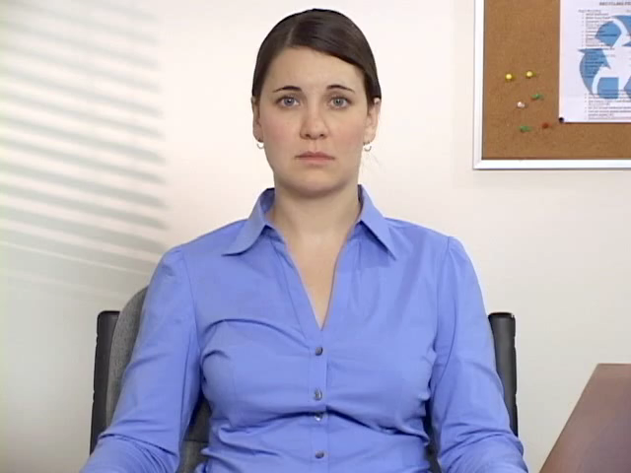
Five Keys
5. Maintain Control
  Maintain control throughout the session to:
    Ensure that all your talking points are addressed
    Help the employee manage her emotions.
  Be sure to:
    Follow your original agenda
    Avoid unnecessary tangents
    Manage confrontations appropriately
    Validate emotions without allowing them to derail you
Click the picture to hear one of Brooke’s responses

Slide 17
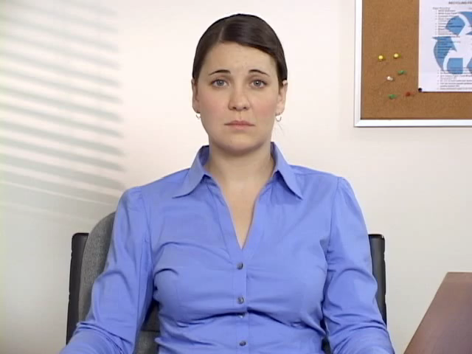
Coaching 5 -7 Model
Applying the Five Keys and Seven Steps will:
  Improve employee performance
  Improve corporate morale in the long term
Click the picture to hear one of Brooke’s responses

Slide 18
Coaching for
Improved Performance
An Overview

